Slide 1
Theia Protoype Mock-Up
TEAM EV
Austin Aragon, Justus Jones, Young Kim, Zichuo Wang, James Zuniga
"THEIA is used by voice, touch, and vibration. The screen is a bonus, not a must."

Slide 2
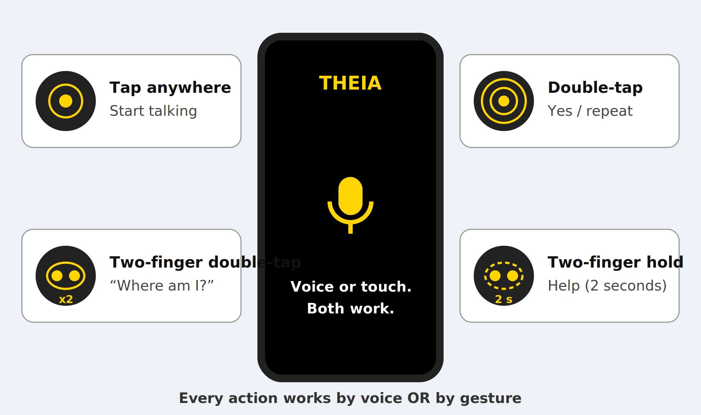
How the user controls THEIA

Slide 3
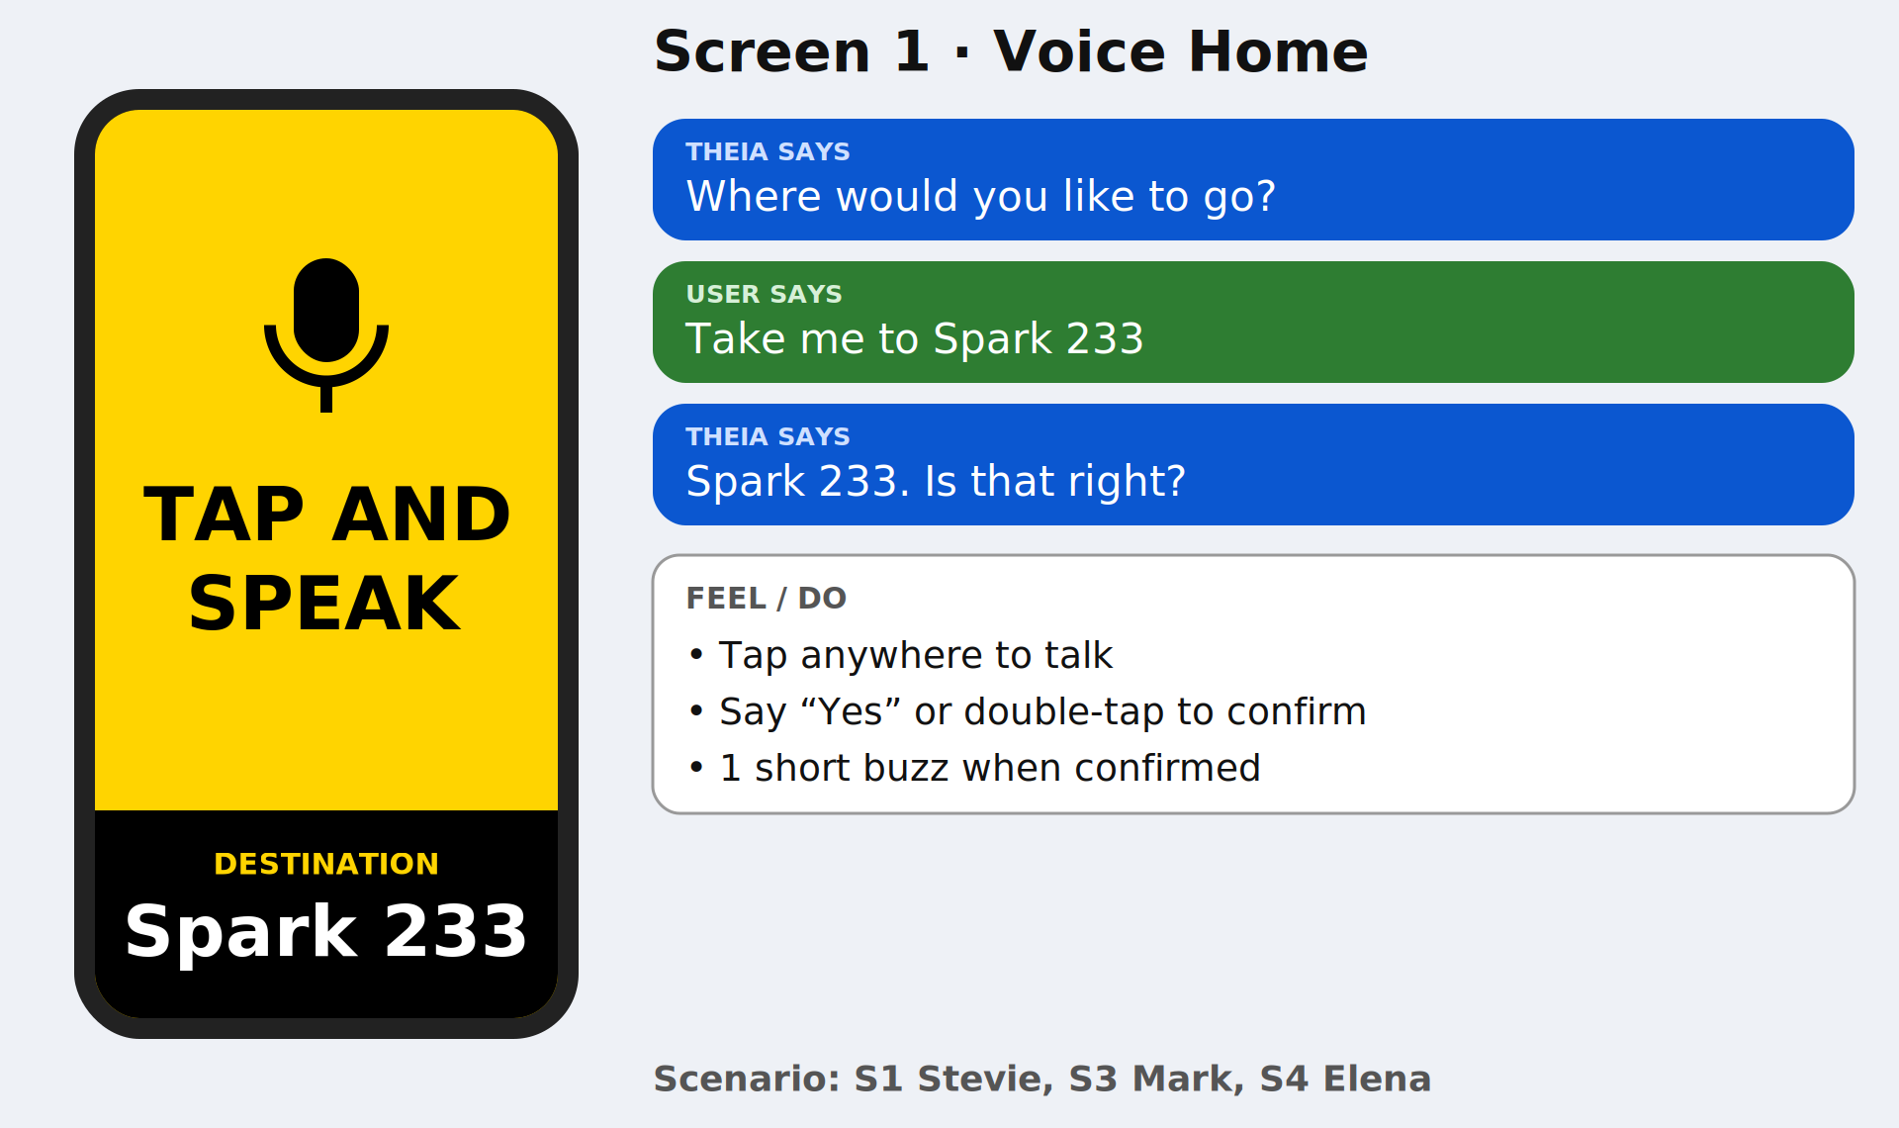
Screen 1, Voice Home
Tap anywhere to talk. Say "Yes" or double-tap to confirm. Short buzz when confirmed.

Slide 4
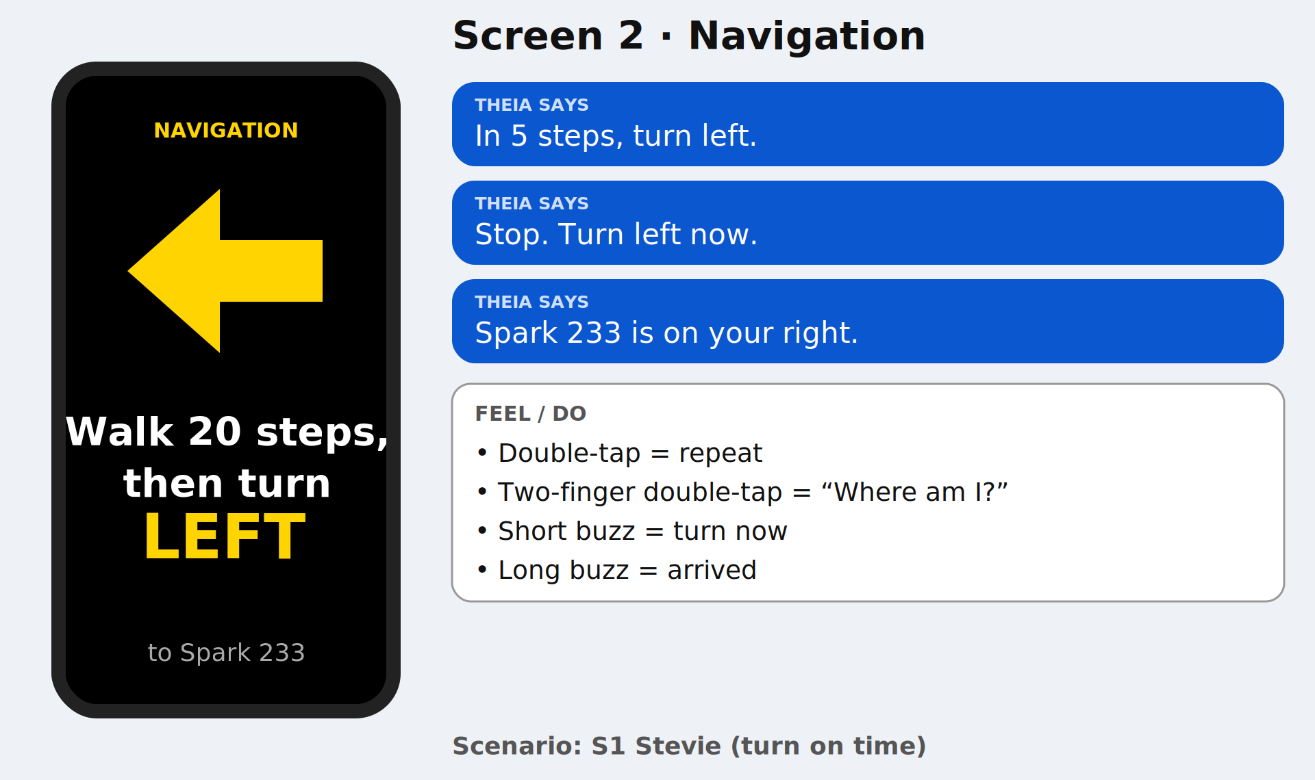
Screen 2, Navigation (non elevator)
Double-tap = repeat. Two-finger double-tap = "Where am I?" Short buzz = turn now. Long buzz = arrived.

Slide 5
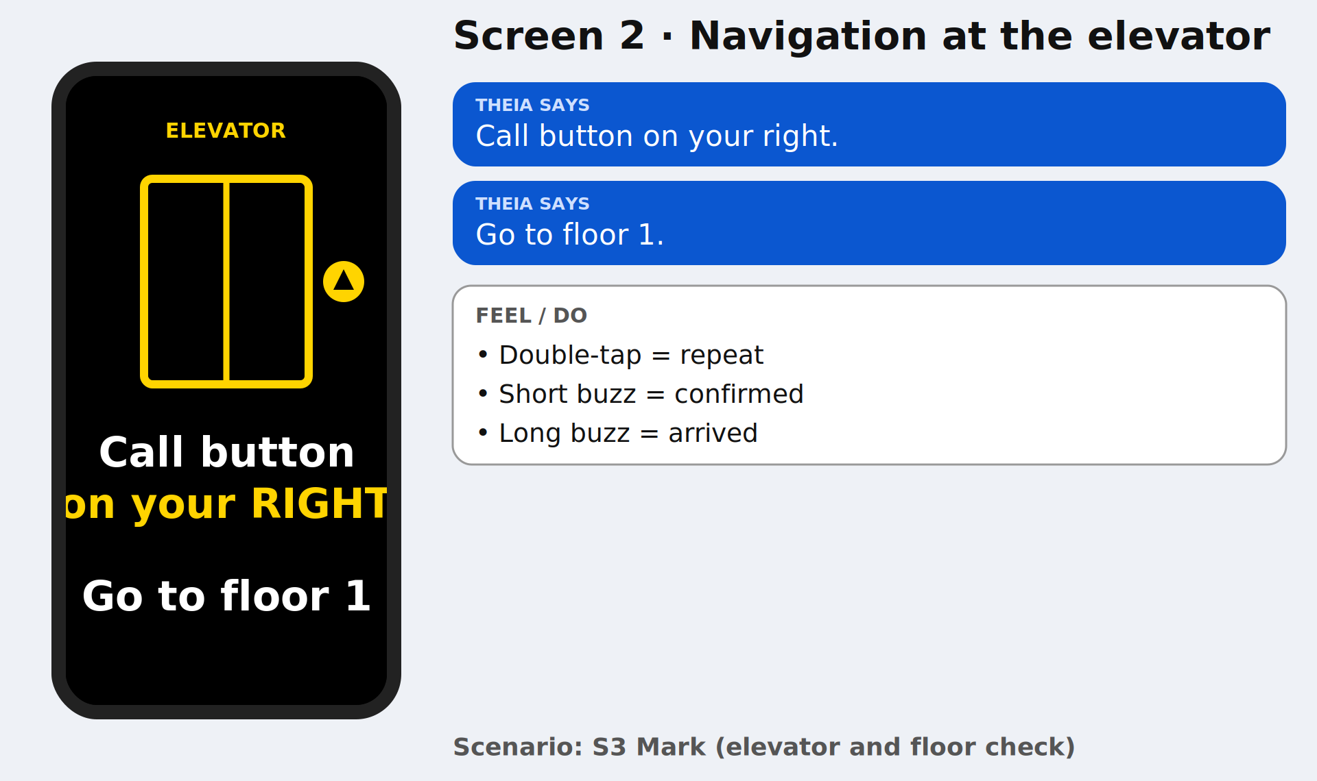
Screen 2, Navigation (elevator)
3 buzzes when off route. Say "1" or "2", or tap the top half or bottom half of the screen.

Slide 6
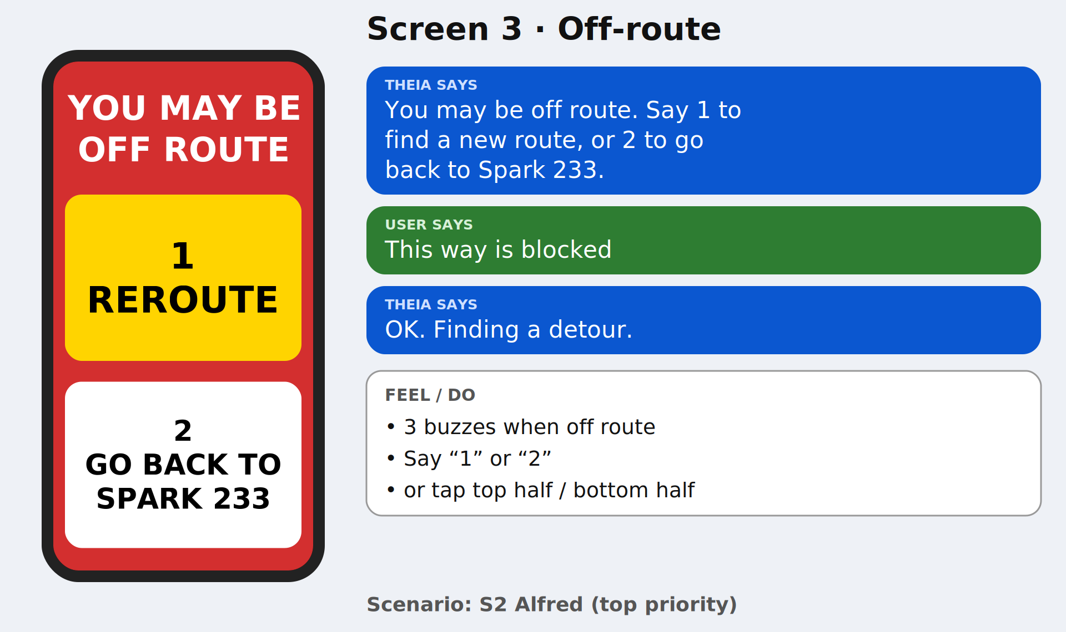
Screen 3, Off-route

Slide 7
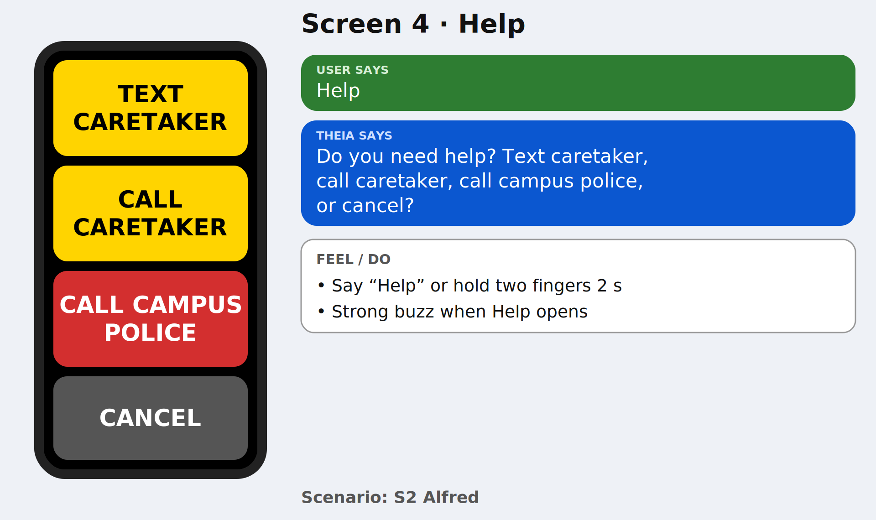
Screen 4, Help
Say "Help", or hold two fingers on the screen. Strong buzz when the help screen opens.

Slide 8
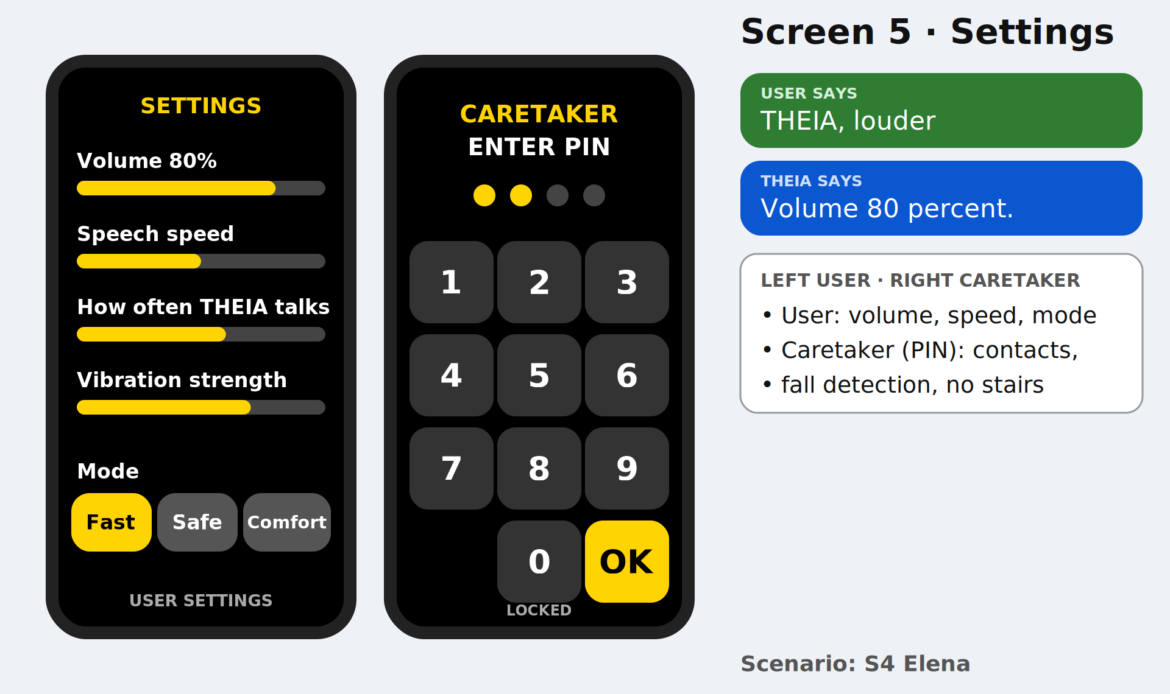
Screen 5, Settings

Slide 9
Voice commands (table)
“User says ____” | Theia responds with this
"Take me to ___" | Starts a route
"Where am I?" | Tells building, floor, nearest room, which way you face
"Repeat" | Says the last instruction again
"This way is blocked" | Finds a detour
"Help" | Opens the Help screen
"Cancel" | Stops the current action or countdown
“Volume down/up, speed slower/faster” | Changes volume of voice and speed of speech
"Fast mode" / "Safe mode" / "Comfortable mode" | Changes route style to pre planned or programmed routes based on info

Slide 10
Gestures
And
Vibrations
Gesture | Meaning
Tap anywhere (Voice Home) | Start talking
Double-tap | Yes/repeat instruction
Two-finger tap | “Where am I”
Two-finger hold(2 secs) | Help
Vibration | Meaning
1 short buzz | Turn now / confirmation
1 long buzz | You have arrived
3 buzzes | Off route warning
Strong continuous buzz | Help screen or fall check opened

Slide 11
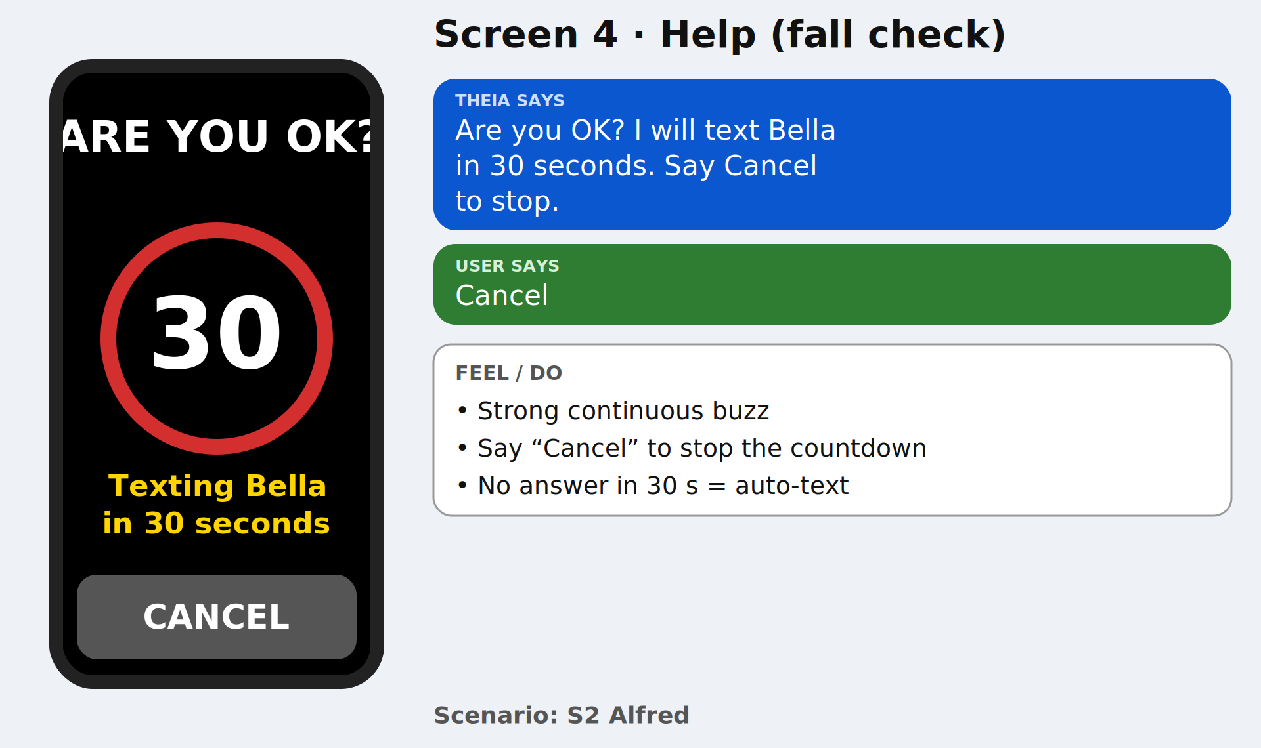
Screen 4-Help (fall check)

